Slide 1
Quantitative and Qualitative Data

Slide 2
Quantitative data are measures of values or counts and are expressed as numbers.
Quantitative data are data about numeric variables (e.g. how many; how much; or how often). Qualitative data are measures of 'types' and may be represented by a name, symbol, or a number code. Qualitative data are data about categorical variables (e.g. what type).

Slide 3
Numeric variable = Quantitative data Categorical variable = Qualitative data
"How much do you earn?" | $60,000 p.a. | "What is your occupation?" | Photographer
"How many hours do you work?" | 38 hours per week | "Do you work full-time or part-time?" | Full-time

Slide 4
Types of quantitative data types
Quantitative data
Continuous
Discrete

Slide 5
Discrete data is a count that can't be made more precise. Typically it involves integers. For instance, the number of children (or adults, or pets) in your family is discrete data, because you are counting whole, indivisible entities: you can't have 2.5 kids, or 1.3 pets.
Continuous data, on the other hand, could be divided and reduced to finer and finer levels. For example, you can measure the height of your kids at progressively more precise scales—meters, centimeters, millimeters, and beyond—so height is continuous data.

Slide 6
QUALITATIVE DATA
Qualitative data is defined as the data that approximates and characterizes.
Qualitative data can be observed and recorded. This data type is non-numerical in nature. This type of data is collected through methods of observations, one-to-one interviews and similar methods. Qualitative data in statistics is also known as categorical data – data that can be arranged categorically based on the attributes and properties of a thing or a phenomenon.

Slide 7
QUALITATIVE DATA
Structured data
Semi structured data
Unstructured data
Big data (Structured data Semi structured data Unstructured data)
Non – Big data
Time series data

Slide 8
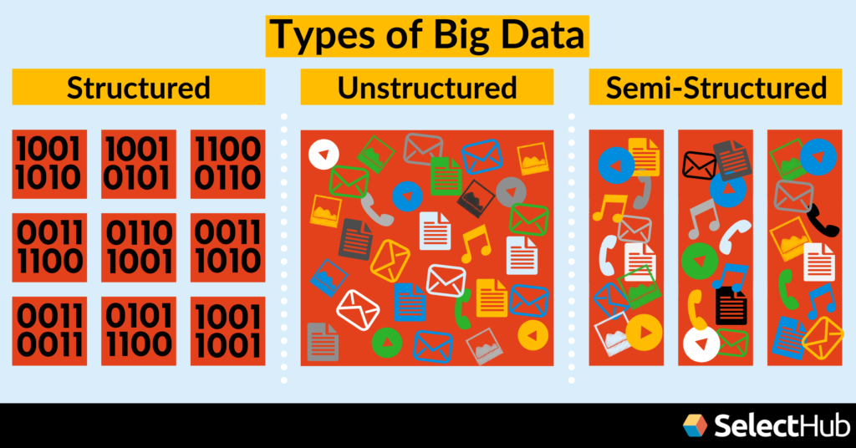
Big data

Slide 9
Structured Data
Structured data is the easiest to work with. It is highly organized with dimensions defined by set parameters.
Think spreadsheets; every piece of information is grouped into rows and columns. Specific elements defined by certain variables are easily discoverable.
It’s all your quantitative data:
Age
Billing
Contact
Address
Expenses
Debit/credit card numbers

Slide 10
Unstructured Data
Data is not orgnised
It is not good fit for relational database.
Word, pdf, text, Media logs etc.

Slide 11
Semi structural data
Does not reside in relational database, but they have some organizational properties that make it easier to analize
With some process it can be stored in relational database
Example – XML data, JSON data

Slide 12
TRADITIONAL DATA OR NO BIG DATA
Centralized database architecture used to store and maintain the data in fixed format.
It deals with structural data
Maintained by all types of businesses starting from very small to big orgnizations.

Slide 13
Time series data
Data for single entity collected for a multiple time period.
Ordering of the observation matters

